Slide 1







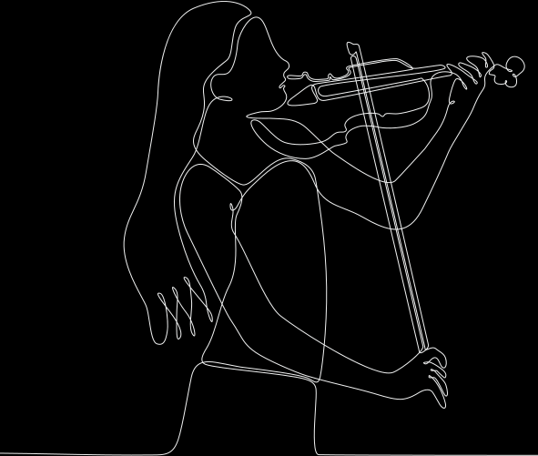
CSF3253: INTELLIGENT SYSTEM
Evolutionary Neural Networks in Algorithmic Art and Music Composition
GROUP 26

Slide 2




Background of the application
The application "Algorithmic Art and Music Composition (Evolutionary Neural Networks)" involves the use of evolutionary algorithms and neural networks to create art and music. Evolutionary music and art refer to the use of evolutionary algorithms to generate music and art, respectively. This involves the use of computational steps analogous to natural selection to produce audio, such as melodies or loops, based on a population of individuals. The process can be initialized randomly or based on human-generated music.

Slide 3


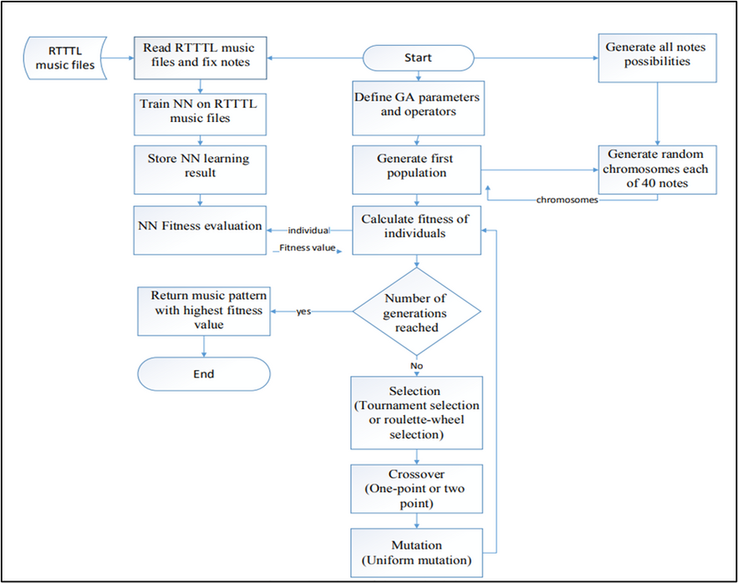
Methodology of
application
Training Set
Melodies are created using sets of monophonic music files in the RTTTL format, involving three parts: title, default parameters, and melody notes.
Artificial Neural Network (ANN)
Trained on melodies with ideal outputs, the ANN distinguishes high and low-quality compositions using backpropagation and the Sigmoid activation function. Its parameters act as a fitness measure in the Genetic Algorithm (GA), enabling the progressive enhancement of melodies.
Genetic Algorithm (GA)
Starting with a random population of 40 music notes, the GA evaluates fitness based on a training set, retaining the top 50%. Selection, crossover, and mutation processes continue over generations, refining musical sequences.

Slide 4

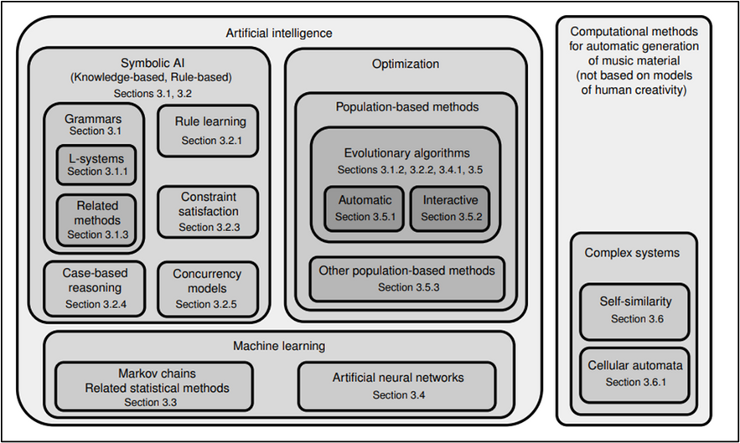
Methodology of
application
Grammars
Formal grammars, like L-systems, are used to generate musical compositions.
Symbolic, Knowledge-Based Systems
Symbolic AI techniques, such as rule-based systems, generate music using case-based reasoning, rule learning, and constraint satisfaction.
Markov Chains
Probabilistic models generate music based on statistical patterns, modeling transition probabilities between musical events.

Slide 5
Methodology of
application
Artificial Neural Networks
Learn patterns in musical data to generate new compositions.
Evolutionary Methods
Simulate natural selection to evolve musical compositions over time.
Self-Similarity and Cellular Automata
Use self-similarity and cellular automata to generate music through the repetition of patterns and simple rule applications on a grid of cells.

Slide 6

benefits of the application
Creativity and Innovation:
Genetic algorithms and neural networks foster innovation in music creation.
Generates novel and creative compositions with unique patterns.
Competence in Composition:
Significantly reduces time and effort in music creation.
Processes large amounts of data efficiently for composition.
Variety and Diversity:
Explores diverse music styles and genres.
Creates compositions catering to different tastes and preferences.

Slide 7

CSF3253
Conclusion
Although algorithmic composition has made significant progress, the quest for true creativity and optimal combination of methods remains an ongoing challenge. The field of algorithmic composition has made significant progress in automating various tasks related to musical composition, including melody generation, harmonization, counterpoint, and orchestration.

Slide 8

CSF3253
Thank YOU

